Slide 1
Project Update 3/27
Josh Howard

Slide 2
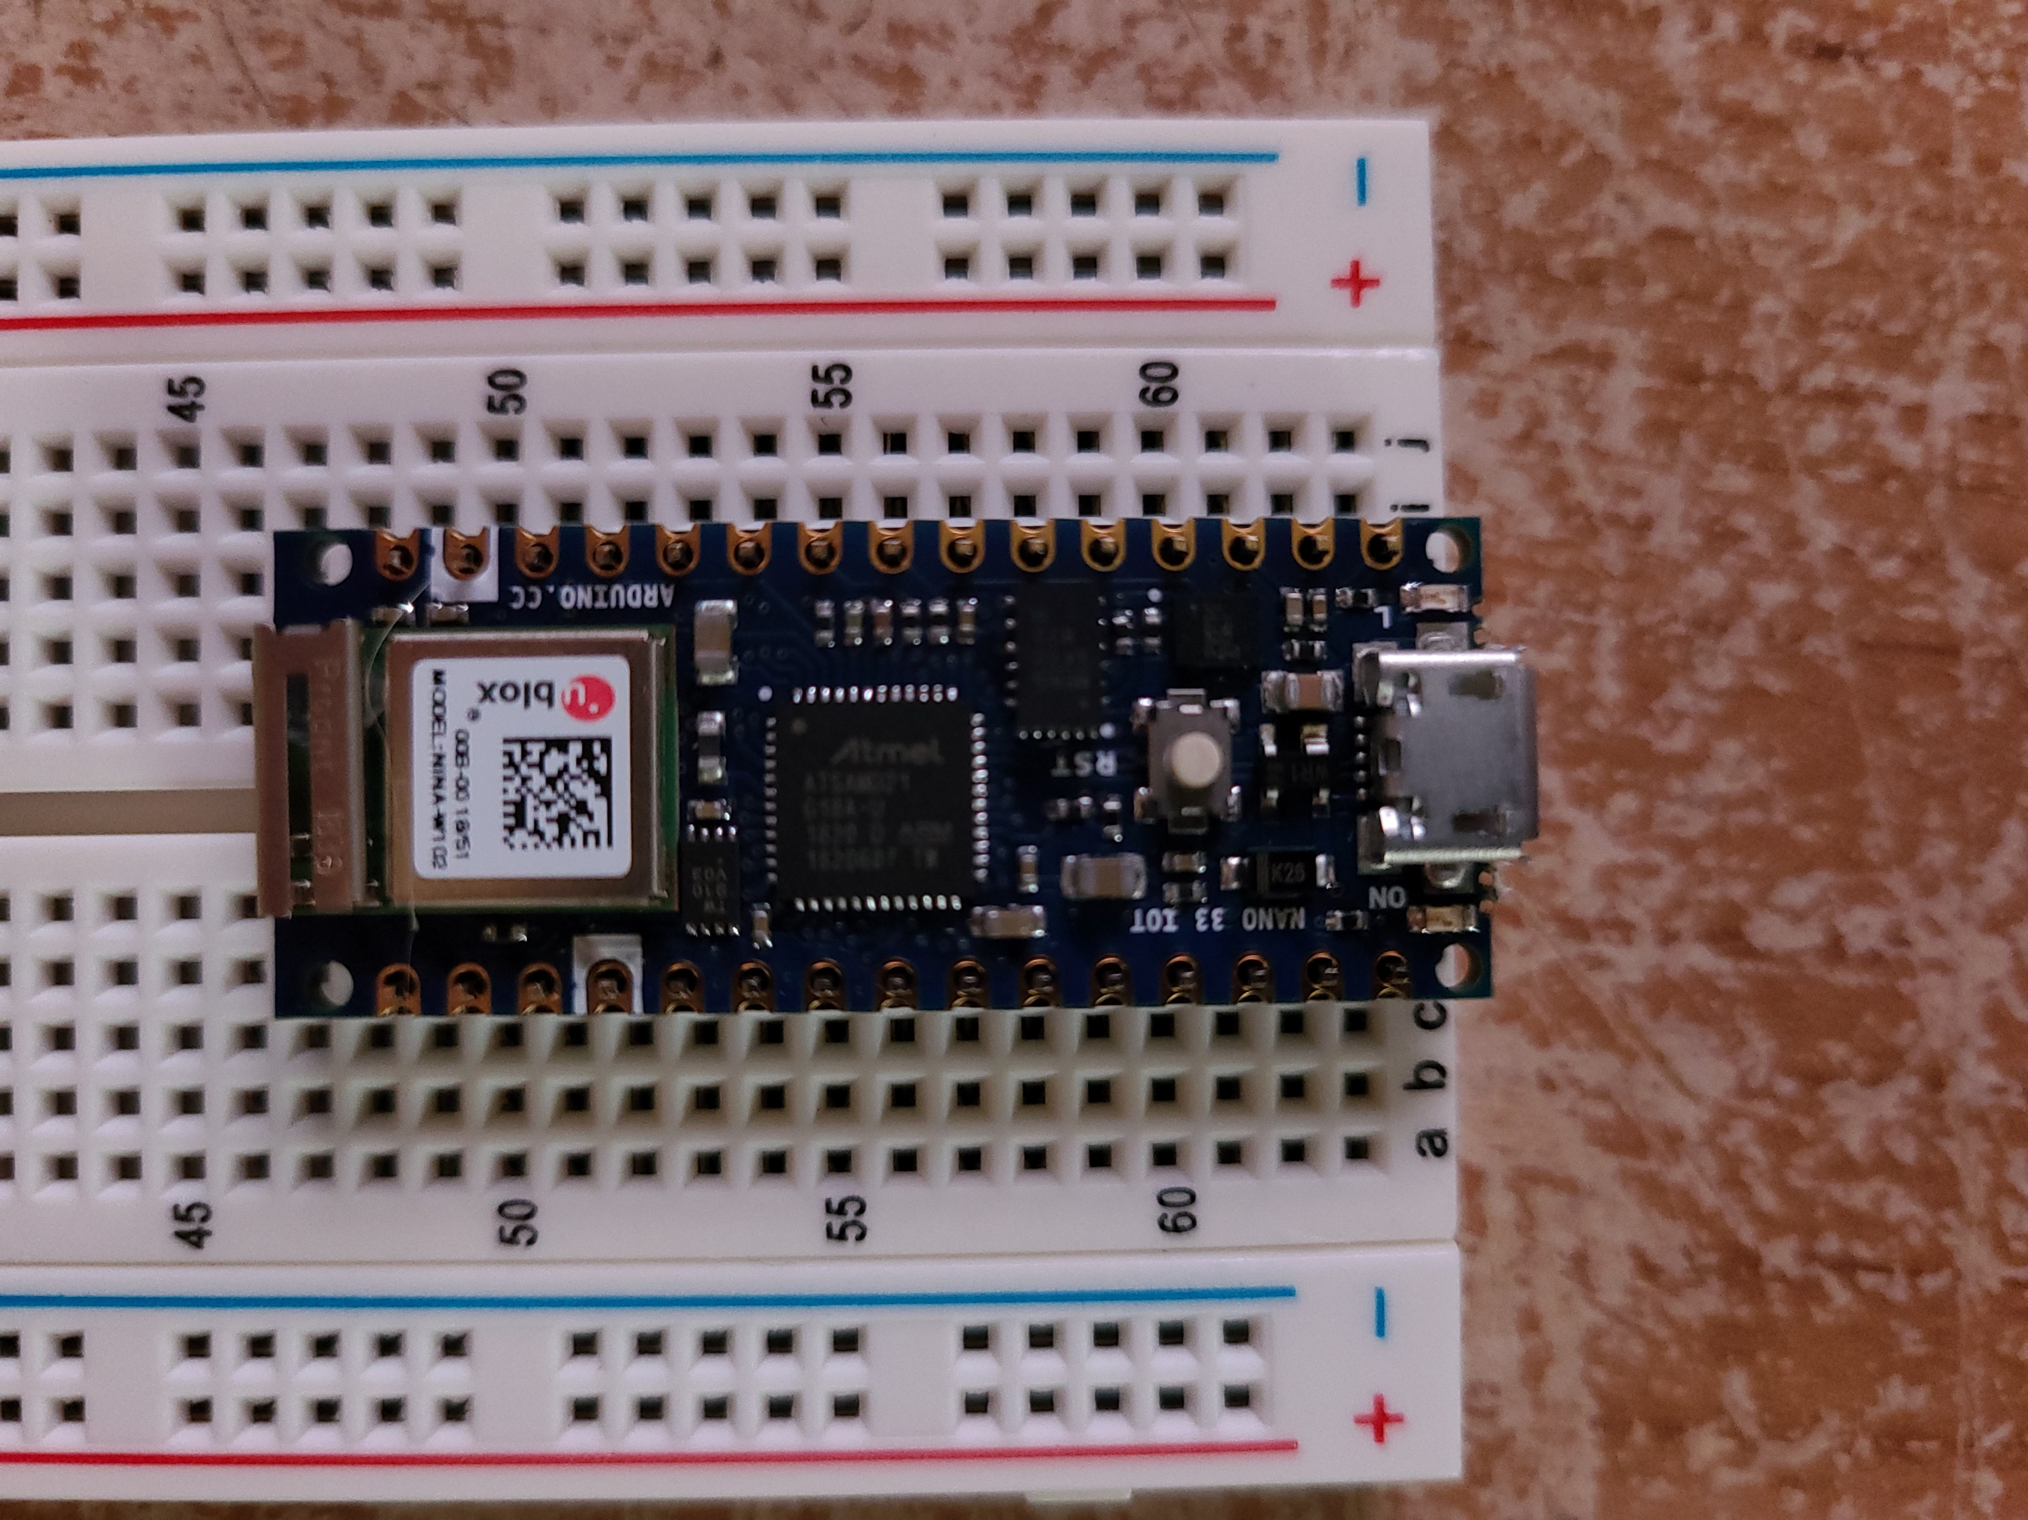
Problems with Arduino Nano
The Arduino Nano I bought didn’t have the headers pre soldered (there is one that comes with soldered headers)
Because of this, when connecting to the bread board most pins wouldn’t connect as it wasn’t touching the Nano. After fighting with it for a few hours I figured soldering them my only option

Slide 3
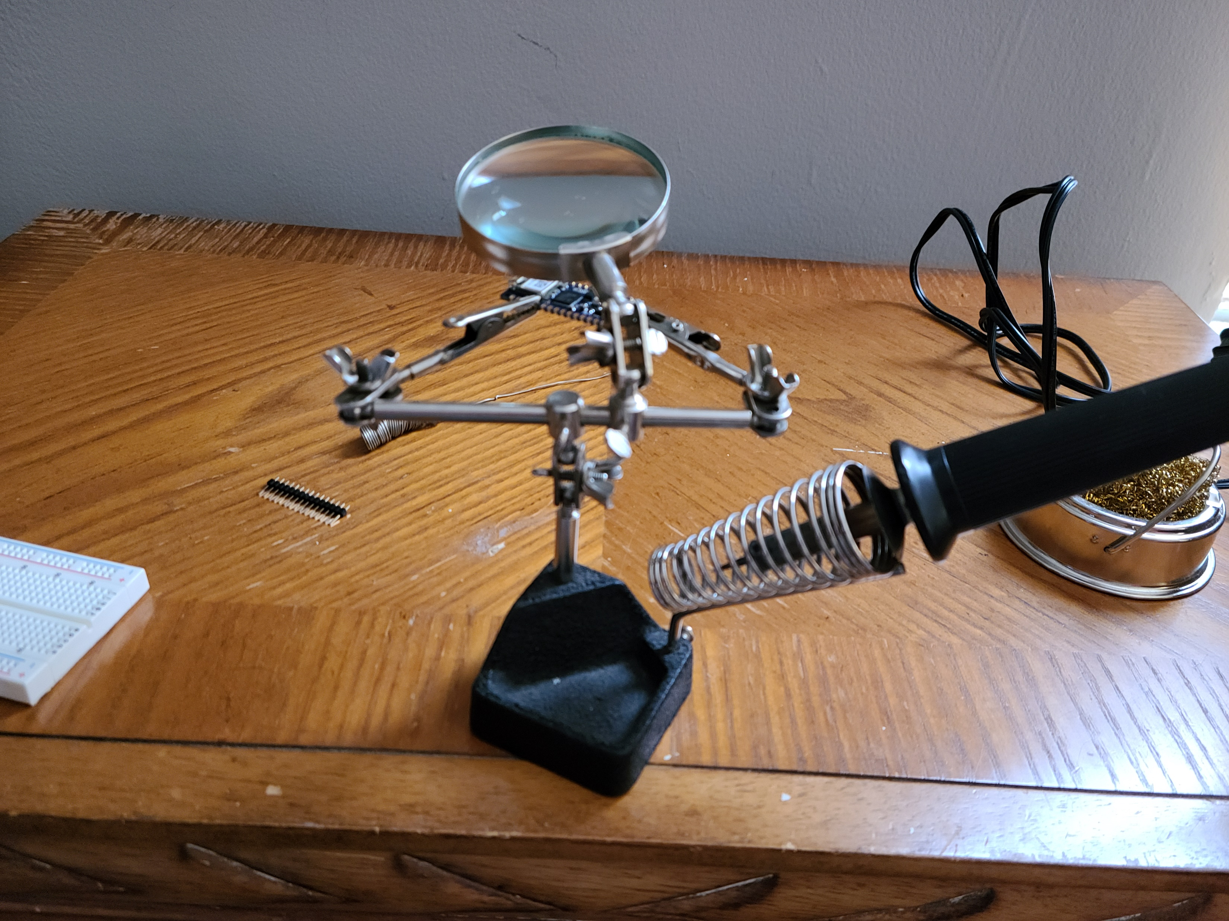
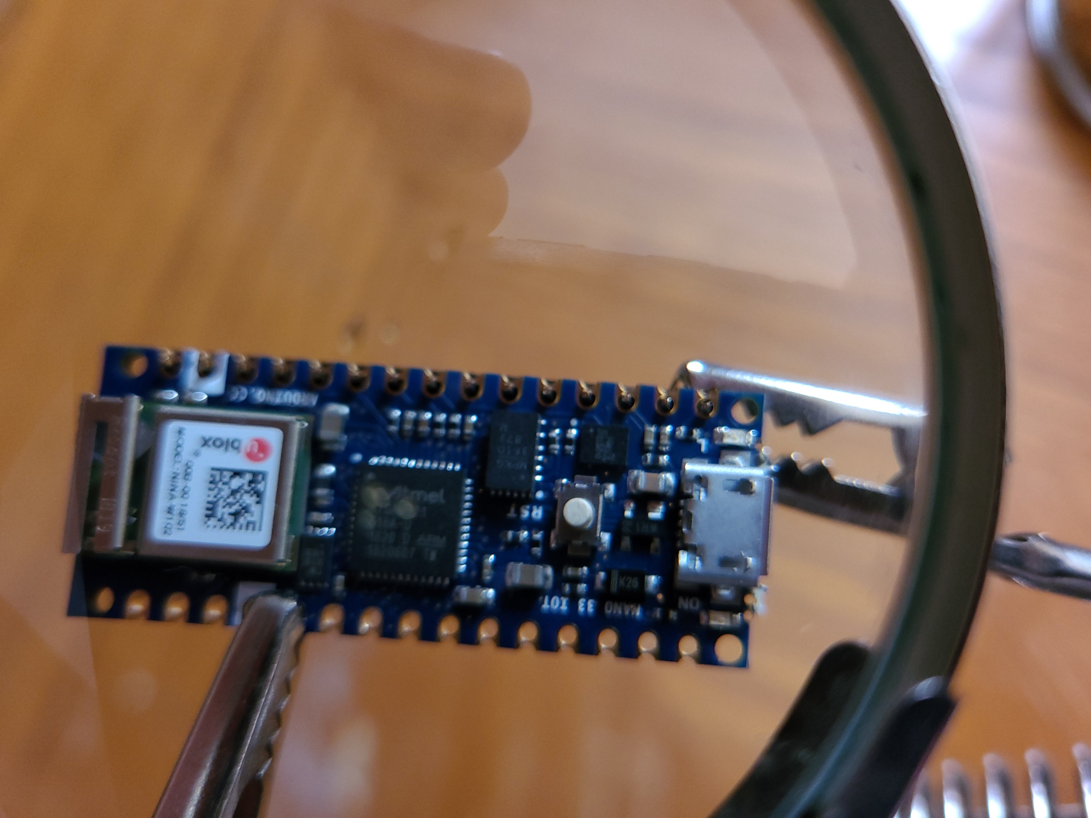
Soldering
I do not own a soldering iron. I did plan on soldering the finished project using the Universities iron in the CompSci lap, but that isn’t available.
I was able to borrow a coworkers small iron he uses for his projects.

Slide 4
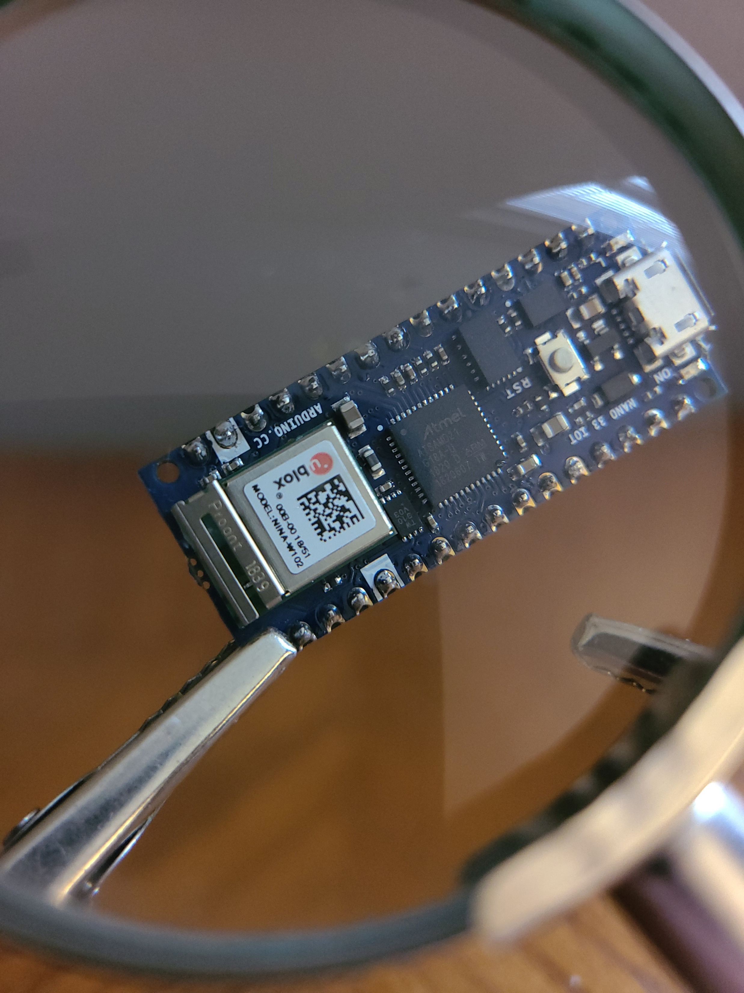
Soldering Done!
Here is just a picture of the Arduino Nano Headers soldered onto the board.

Slide 5
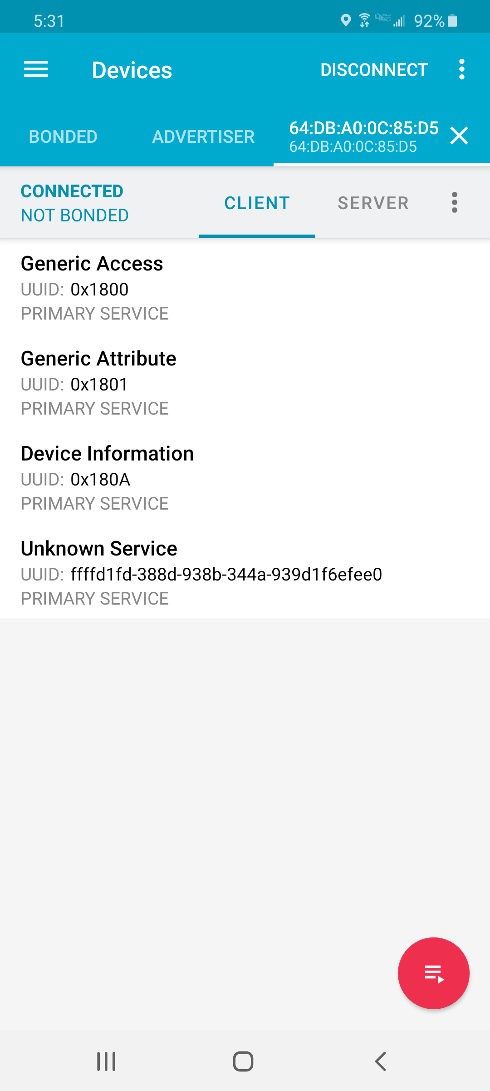
Bluetooth Testing
Though there isn’t any functionality in it at the moment, I was able to get the Nano to broadcast over Bluetooth. The picture to the right is the device page in “nRF Connect” for android. It is currently just the info about the device broadcasting

